Slide 1

Yelp Restaurant Reviews
Insightful Topics
DevUp Project Part 2- Mackenzie Bogiages

Slide 2
Agenda
Topic
Introduction and Problem Statement Methods and Exploratory Analysis Top Cuisines and Keywords Topic Modeling Sentiment & Correlation

Slide 3
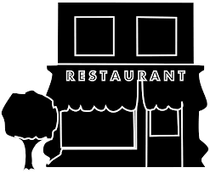
Introduction and Problem Statement
Yelp data set
Focusing on restaurants in Illinois
Over 4,000 restaurants listed on Yelp
Use data for reviews, businesses, and check-ins and drop unused columns
4,808 rows
18 columns
Problem Statement
The Mayor of Chicago wants to understand restaurant performance.
Key Themes:
Word cloud – popular keyword for each cuisine
Topic modeling
Optimal number of topics
Correlation between star rating and sentiment of reviews

Slide 4
Methods
Data Source
Yelp data set
Python
Look only at businesses with the category restaurant
Look only at businesses in the state of Illinois
Word Clouds
Make word clouds based on reviews for the 50 restaurants with the most reviews for each cuisine to increase processing speed
Topic Modeling
Remove special characters
Make all letter lowercase
Remove stop words
Use LDA and pick model with highest log likelihood
Sentiment and Correlation
Use TextBlob’s sentiment to calculate sentiment polarity and subjectivity for each review
Analysis
Visualizations and modeling in Python via Jupyter Notebook

Slide 5
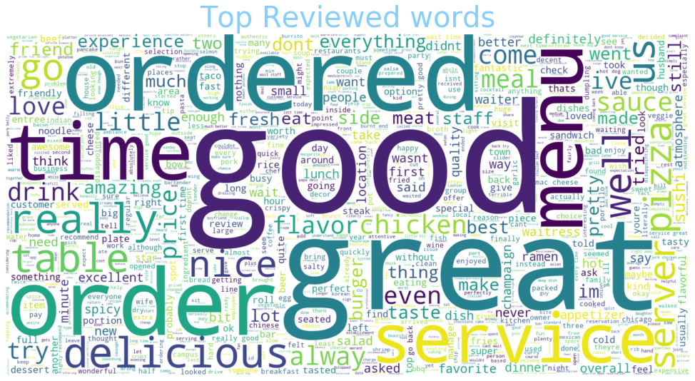
Word Cloud – All Cuisines

Slide 6
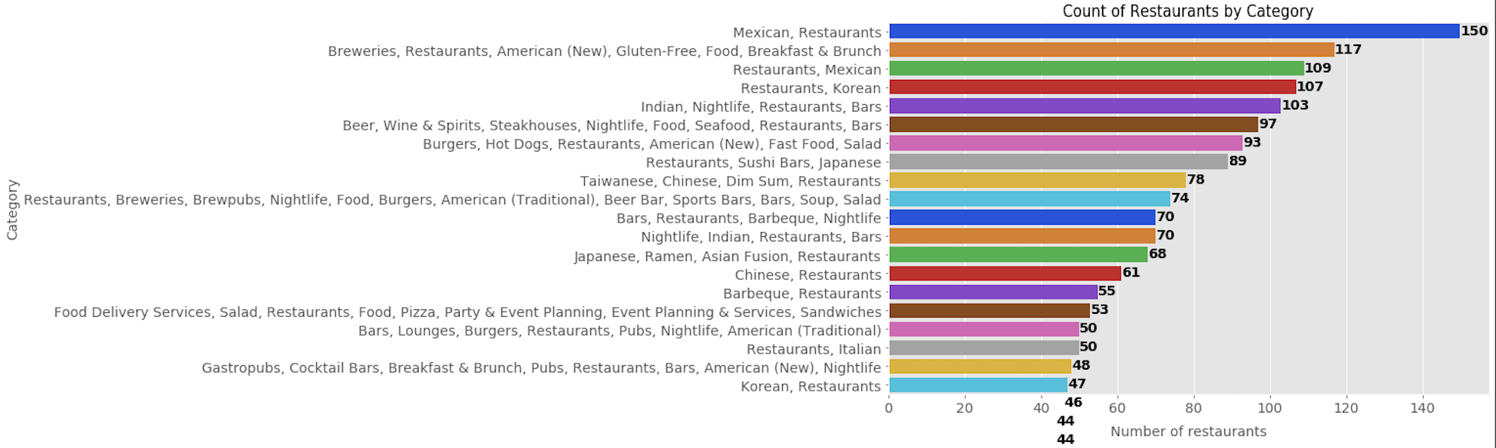
Top Cuisines
There are some cuisines that can be combined. We will look at cuisines that contain certain key words pertaining to top cuisines.
Top 10 cuisines when combined: American (1294), Burger (576), Mexican (478), Chinese (408), Barbeque (322), Korean (286), Italian (249), Indian (240), Steakhouse (214), Seafood (181)

Slide 7
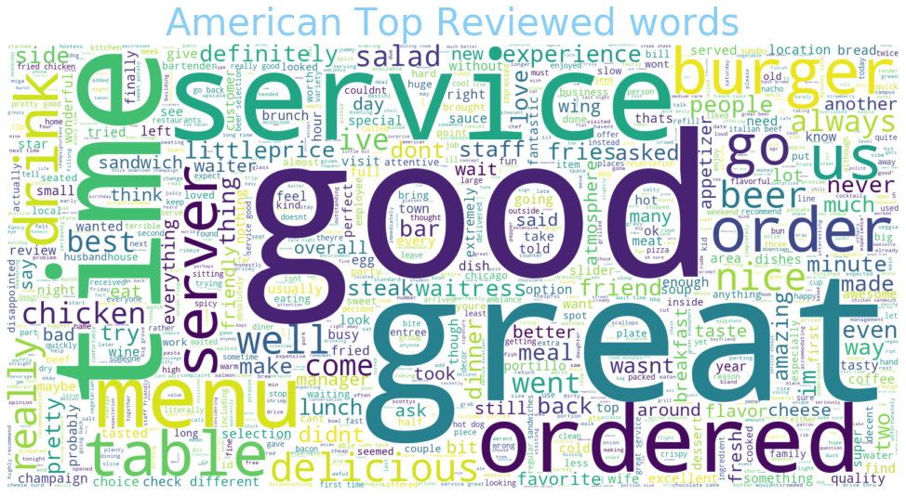
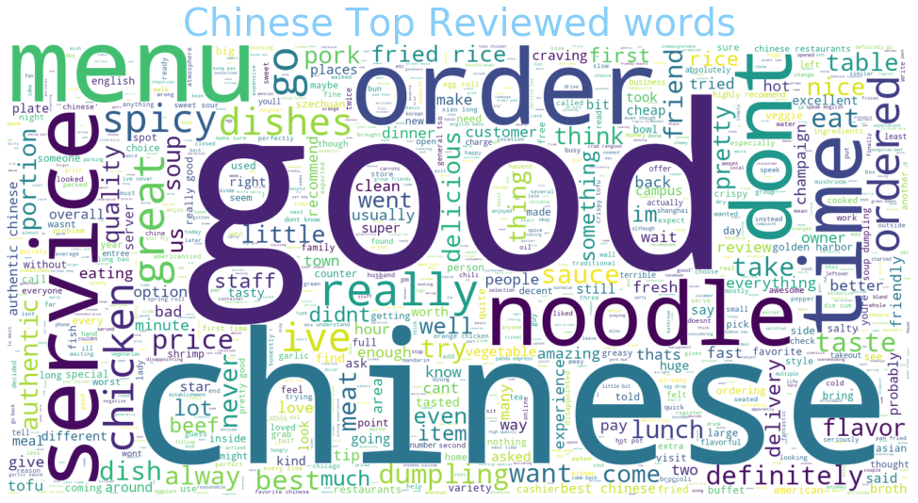
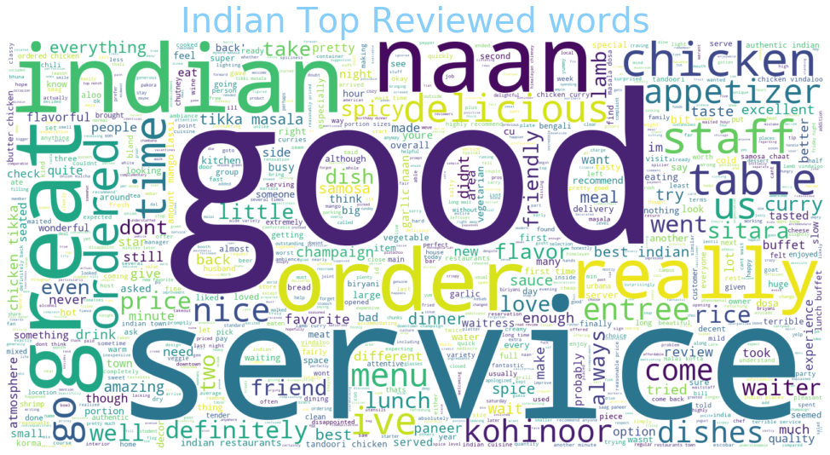
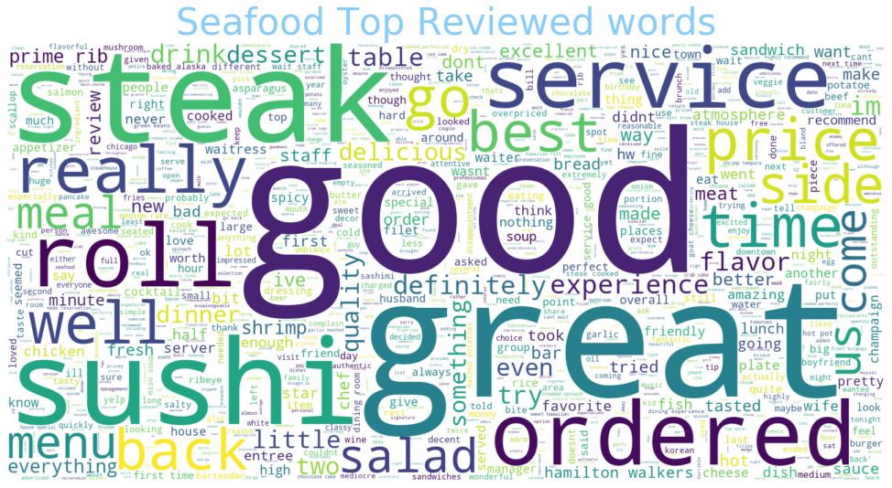
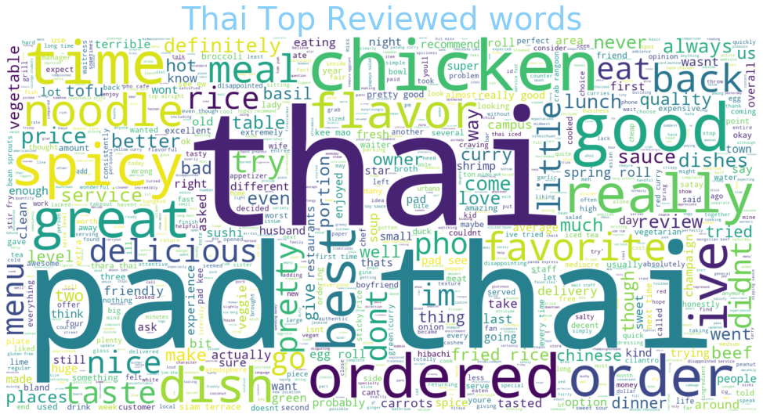
Word Cloud – American, Chinese, Indian, Seafood, Thai
These five cuisines are similar in that the reviews focus on more generic cuisine words such as “Chinese”, ”Indian”, and “Thai”

Slide 8
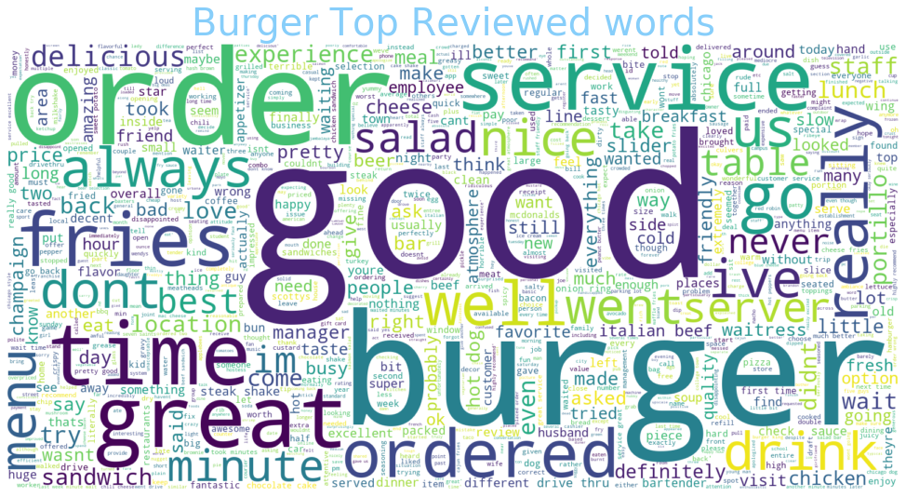
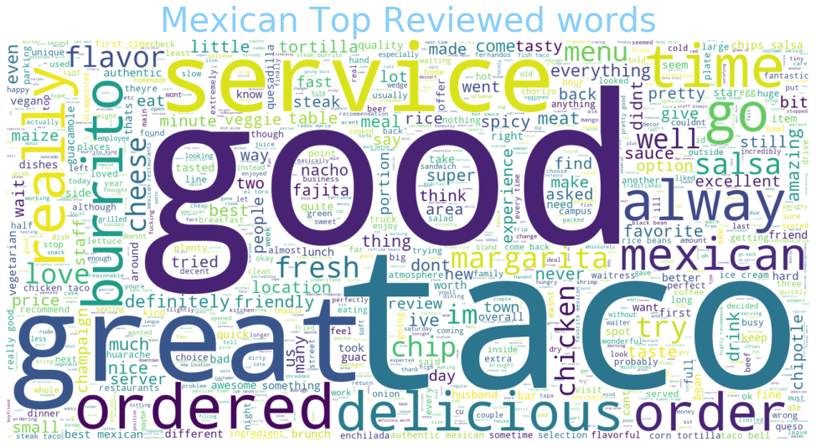
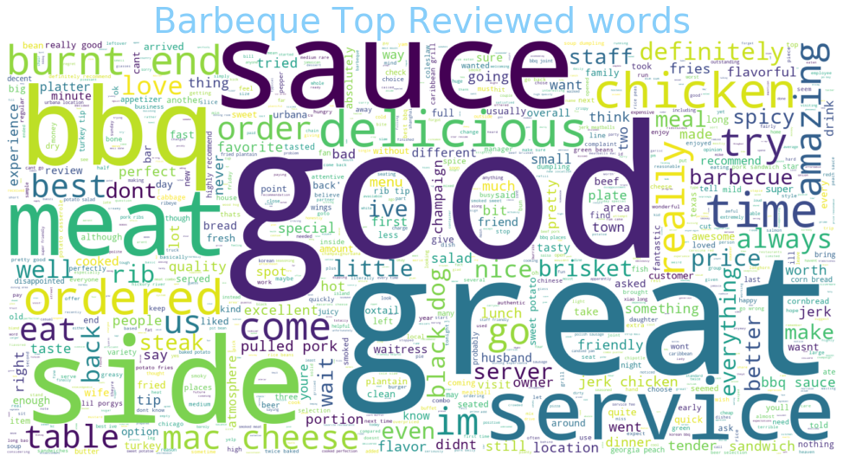
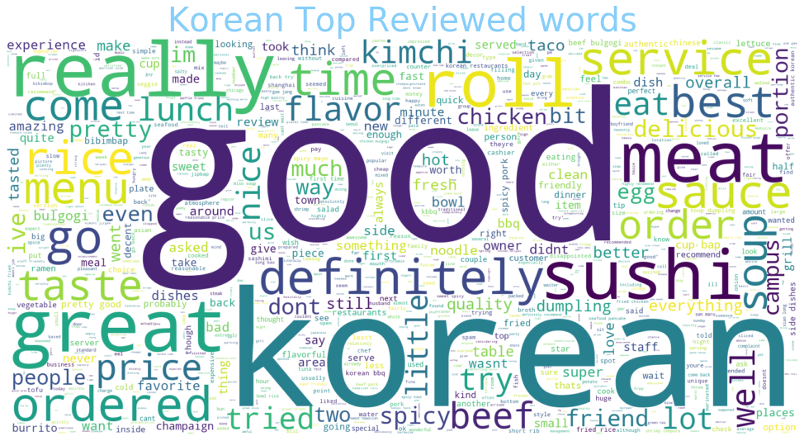
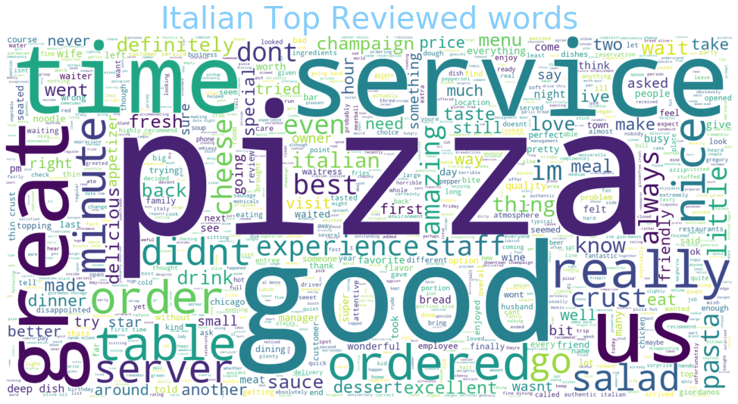
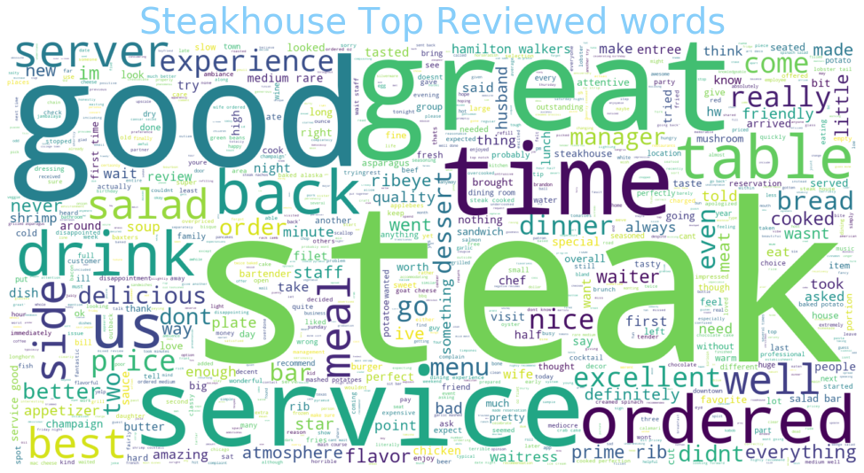
Word Cloud – Burger, Mexican, BBQ, Korean, Italian, Steakhouse
These six cuisines have many of the same generic terms as the previous ones, but also focus on the specific food types associated with each cuisine like “sauce”, “pizza”, “taco”, and “meat.” There is nothing surprising about the word clouds produced from the top 50 reviewed restaurants for each cuisine.

Slide 9
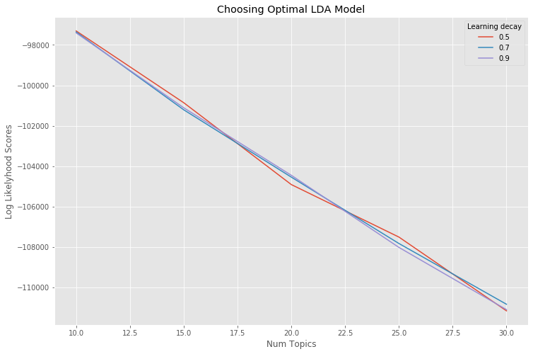
Topic Modeling - LDA
The optimal LDA model has:
learning curve = .5
n components = 10
log likelihood = -97306.86
perplexity = 481.69

Slide 10
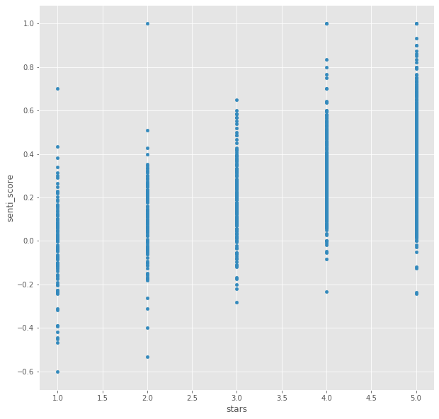
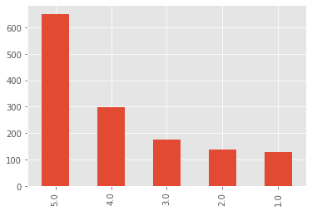
Sentiment and Correlation
Stars vs Sentiment score
Count of Stars
The highest correlation calculated is the R² between sentiment score polarity and number of stars, .5511. R² decreased when we looked at just negative (stars – 0, 1 or 2) or just positive reviews. The correlation between sentiment score subjectivity and number or stars is much lower, .2482.
The sentiment of each review was calculated using TextBlob’s sentiment.

Slide 11
Conclusions and Next Steps
Conclusions:
There is a moderate correlation between sentiment score polarity and number of stars given in a review
There is a lot of similarity in generic restaurant words between reviews for different cuisines
Some cuisines have reviews that are more specific to their food types such as Burger, Mexican, BBQ, Korean, Italian, and Steakhouse
Future Recommendations:
Look at all restaurants for the word clouds instead of just the 50 most reviewed
Investigate the downward trend displayed by the LDA number of topics graph
Refine LDA model to increase log likelihood and decrease perplexity
Clean text reviews more to account for slang, for example, a review saying “the ozu was mad dank” left 5 stars, but had a sentiment score of -.1186 from TextBlob
IBM Confidential

